Slide 1
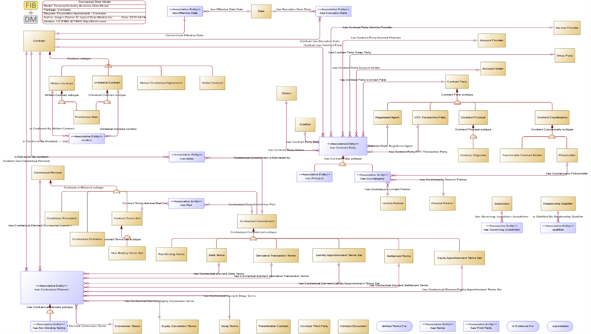

















Semantics for EMB,
Everyone’s Midsize Bank
Financial Industry Business Data Model & Ontology (FIB-DM & FIBO)

Slide 2


FIBO is the authoritative model of Financial Industry concepts, their definitions, and relations.
The Enterprise Data Management Council (EDMC) is the Global Association of over 200 Financial Institutions (FI).
Data Management best practices
Development and implementation of Data Standards.
EDMC members, mainly the large FI*, developed the Financial Industry Business Ontology (FIBO), a business conceptual model.
More than 1600 classes detail financial instruments, business entities and processes.
*The EDMC membership Tier A starts at $200 billion in assets under management. Midsize banks for FIB-DM licenses, and this document are banks with assets between $50 and $200 billion.

Slide 3
Everyone’s midsize Bank (EMB)
Data architecture team
What?
How?
Logical & Physical Data Modeling
Data Management & integration
Policies, rules, and standards
Support for programs and projects
Data Modeling Tool
Vendor Data Model (s)
Data Management Capability Assessment Model (DCAM)
Next?
Looking at FIBO
Ontologies
Semantic technologies
Industry Standards

Slide 4
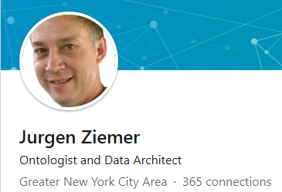



Recognized FIBO and Industry DM expert
“Jurgen was a key participant in our work on the Financial Industry Business Ontology (FIBO) - an open ontology about financial instruments, entities and contractual obligations. He is a skilled ontologist who understands the application of linked data and semantic technology. I've had him speak to our industry when I ran the Enterprise Data Management Council and relied on his expertise to advance our work on semantic standards.” (Michael Atkin, Managing Director at the EDM Council)
“Jurgen has taught my team and me so much about data, specifically ontologies, structures and standards. We started out as a group with no knowledge of ontologies, triple stores, RDF, OWL or industry standards like FIBO. He trained my architects (some of whom I'd now call ontologists) and he's been an excellent source of knowledge for all things data, especially new innovations in language and semantics. We've relied on him as our resident expert and I've loaned him out to other parts of the bank (who've also learned about semantics and ontologies). Jurgen was a great addition to our team, a great contributor to our work and I'd have him back whenever I can.”
(Shannon Walker, Director at Deutsche Bank)
“Calling Jurgen a data modeler is a huge understatement. Jurgen's contribution to our work in GTS was foundational and invaluable. Part evangelist, part subject matter expert, part data modeler, and part strategist, Jurgen brings the force of his personality and vision to every assignment, which happens to be a very good thing for the enterprise. Jurgen is also very willing to contribute not only to the strategic agenda but also to the workaday agenda, creating work products which move the project forward. In the era of model-centric enterprise architecture, Jurgen can be a game-changing component to your strategy. Above and beyond professional qualifications, Jurgen is also a good colleague and a good business partner.” (Vin Siegfried, SVP at Citi bank)
https://www.linkedin.com/in/jurgenziemer/

Slide 5
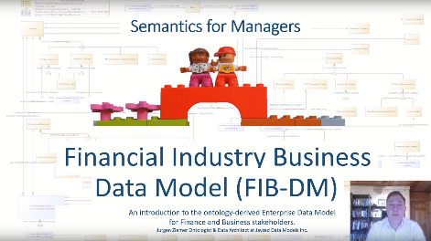

There is a chasm between semantic and conventional data management.
https://fib-dm.com/semantics-for-managers/
Large Financial Institutions (FI) already implemented FIBO.
Mid-size banks face high barriers: Tooling, database systems, and human expertise.
The EDMC specified FIBO in Ontology Web Language (OWL).
OWL needs highly specialized ontologists.
IT-departments must still support and design relational databases.
No midsize bank has an RDF-store in production
OWL runs on specialized databases, RDF (triple) stores

Slide 6

FIB-DM is the bridge across the chasm.
The Industry Standard is available in your Data Modeling tool.

Slide 7










Semantic Enterprise Information Architecture
Use | Type |  | Level
Business | Conceptual |  | Enterprise
Design | Logical |  | Department
 | Physical |  | Project
Development
 | Implementation
FIB-CM
FIBO
RDF
OWL
FIB-UM
FIB-DM
Data Model
RDBMS
RDF
Data
Message
Process
Object
Semantic Model-Driven Development, common names, definitions and design patterns.

Slide 8
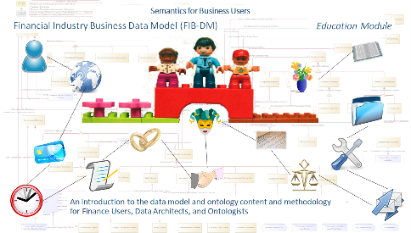

FIB-CM 15 concepts mnemonic icons, and abbreviations
70% of FIB-DM entities are a subtype of the concept entity
AA
Autonomous Agent
REF
Reference
OCC
Occurrence
ARR
Arrangement
SVC
Service
AGR
Agreement
DOC
Document
COM
Commitment
CE
Contractual Element
LC
Legal Construct
AC
Account
TI
Time
LOC
Location
TIR
Thing in Role
PRD
Product
https://fib-dm.com/semantics-for-finance-users/
Enough to visualize design in user-friendly concept maps
F
Finance user

Slide 9
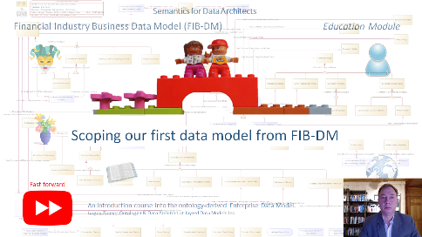
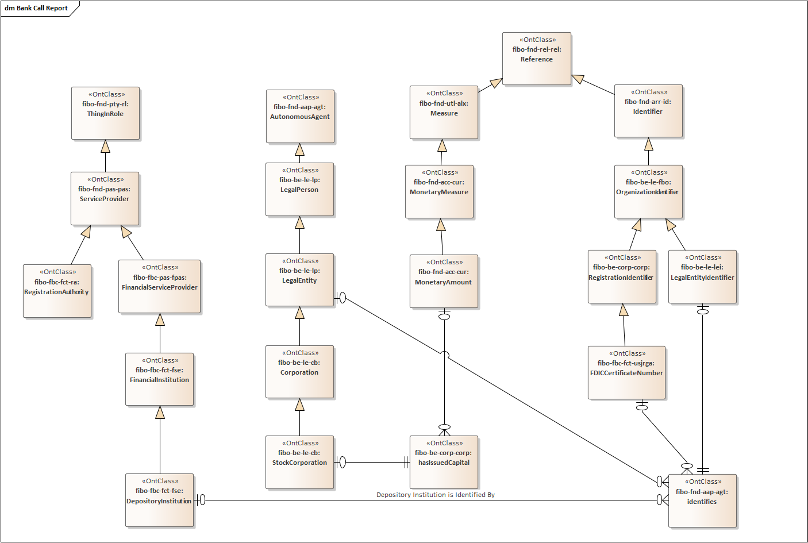
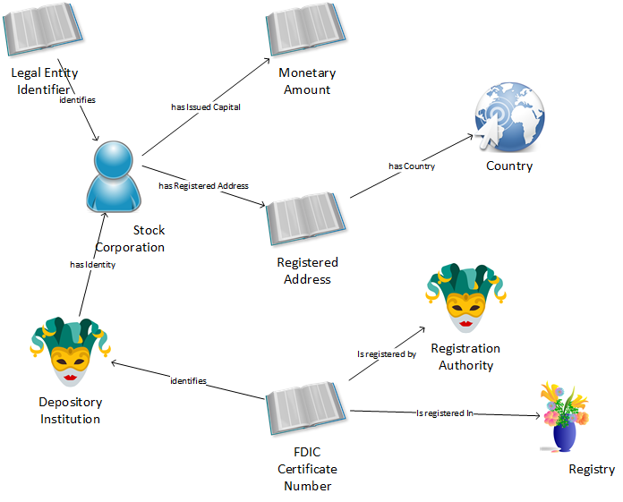
The concepts and vocabulary directly derive from the data model.
https://youtu.be/pk6Ul0ghnZE
Finance, Business User
Data Architect
(MS-Visio)
(Sparx EA)

Slide 10
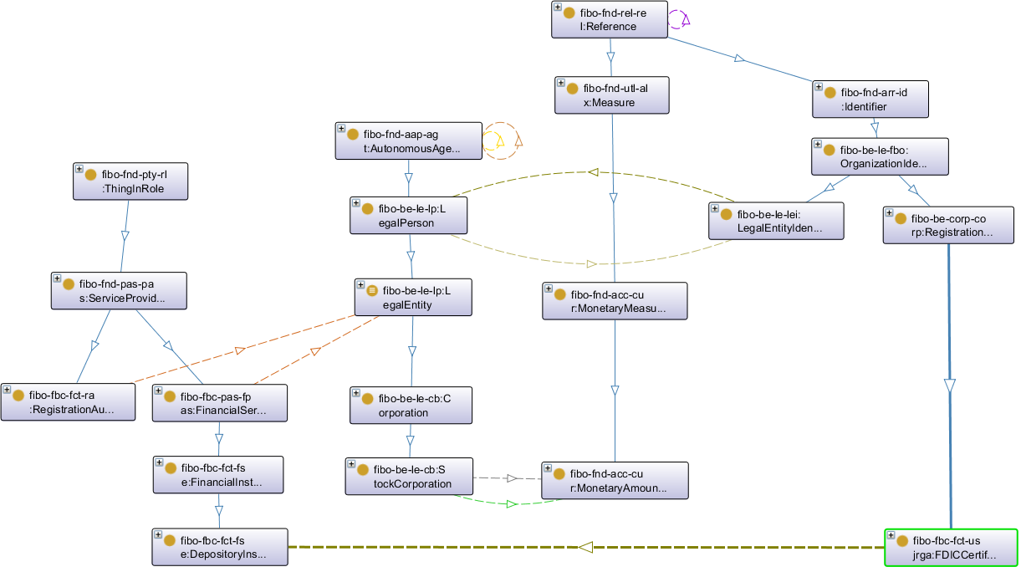
The concepts and vocabulary directly correspond to the ontology.
Finance, Business User
Ontologist
(MS-Visio)
(Protégé)

Slide 11
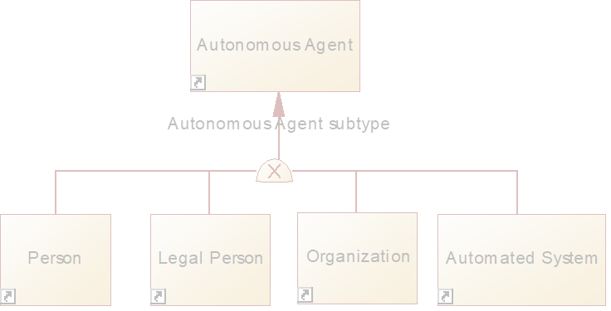
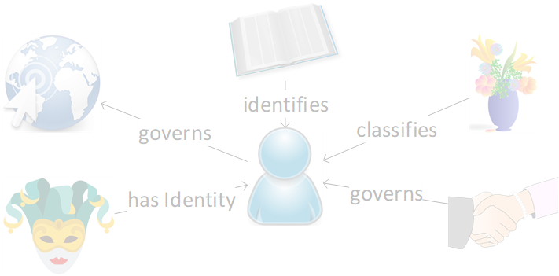
Guide to the Reference Sheets
Concept Name (Abbr.)
important Subtypes
Icon
FIBO definition (cursive)
81
Number of subtypes
Explanation, examples and most important subtypes
Note: The FIB-DM website has fully scalable diagrams of the complete subtype hierarchies. Download the SVG files here:
https://fib-dm.com/financial-industry-business-concept-diagrams/
Explanation and examples of concept relationships
significant Concept Relationships

Slide 12
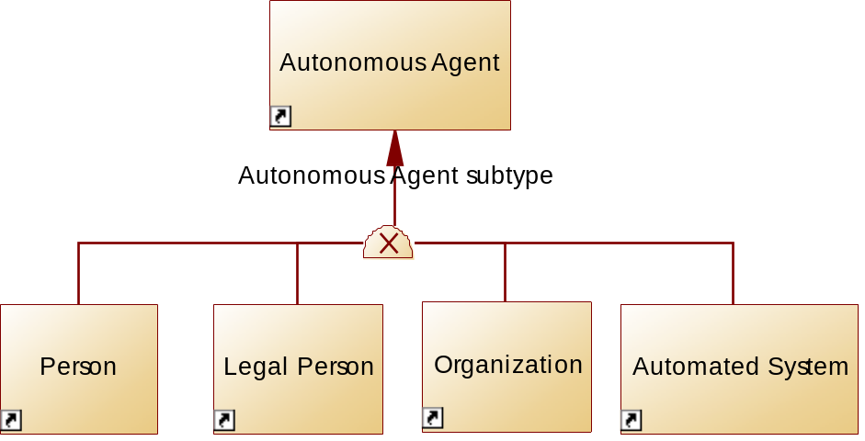
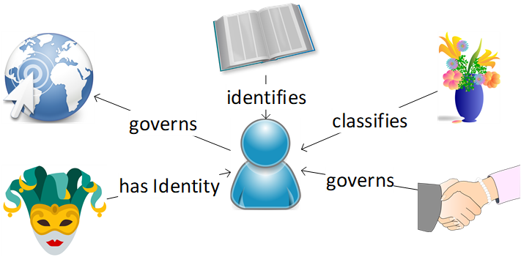
Autonomous Agent (AA)
https://fib-dm.com/semantics-for-finance-users/
An agent is an autonomous individual that can adapt to and interact with its environment.
The Person is an intuitive subtype of an autonomous Agent. There can only be one record of You in an Autonomous Agent table.
Likewise, there must be only one record of Legal Person with its subtype Legal Entity, Organization and Automated System.
81
Foremost, the Autonomous Agent is the identity for Things in Role. Your roles as an investor, borrower, guarantor, all converge to one person.
IDs identify the AA.
Various Arrangements classify the AA.
Government Entities govern Locations, such as a country or municipality.
In turn, Agreements govern certain Legal Entities and Organizations.

Slide 13
Barriers to leveraging FIBO for DA (stories)
Large New York Bank needs Schema for the new Security Master System, trying to leverage FIBO for Logical Data Model.
Challenge: Data Architects are not familiar with RDF/OWL and have no experience in Protégé or Topbraid
Manual workaround: Ontologist writes SPARQL queries to extract metadata into MS-Excel spreadsheets.
Update: In September, the NYC bank downloaded the FIB-DM core.
Connecticut Hedge Fund Ontology For SEC compliance needs a relational platform
Challenge: Converting operational ontology of some 200 FIBO and hedge fund specific classes
Manual workaround: Transcription of graphs into ERWin diagrams.
Challenge: Data Architects are not familiar with RDF/OWL and have no experience in Protégé or Topbraid
Manual workaround: Manual transcription of ontology graphs into your data modeling tool. Copy & paste FIBO documentation.
EMB

Slide 14

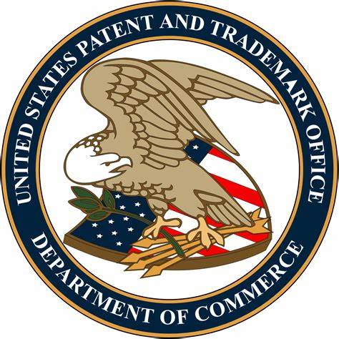
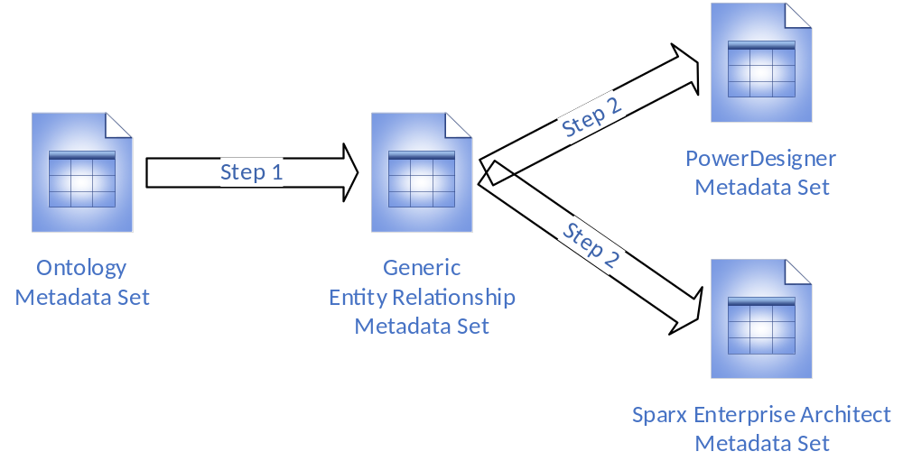


Configurable Ontology to Data –Model Transformation (CODT)
Sparx imports Comma Separated Value, CSV files. To support the Class Model transformation, we add Sparx-specific metadata sets and the Step 2 transformation rules. Both tool-specific metadata sets source from the same generic EA.
XLSX
CSV
We used Sparx EA to generate the UML XMI.

Slide 15
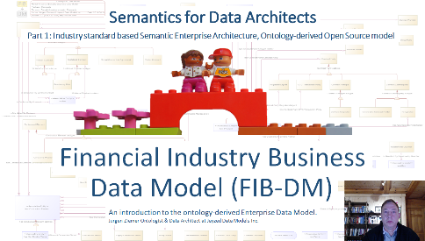
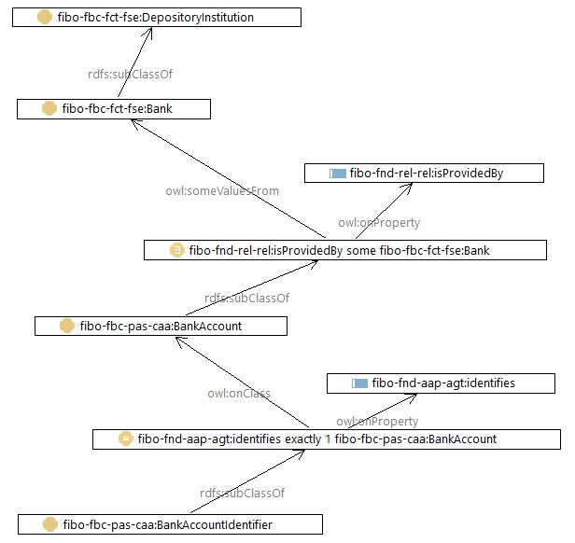
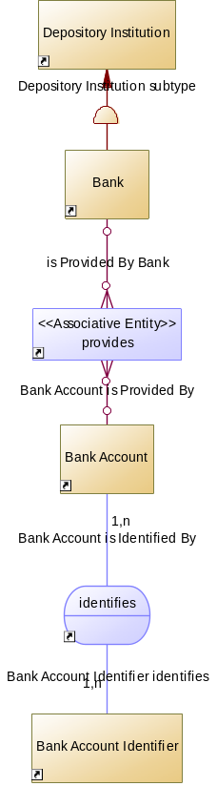
Domain ontology generates a perfect CDM
https://fib-dm.com/semantics-for-data-architects/
Ontology graph, FIBO
Conceptual Data Model, FIB-DM
This entity-relationship diagram is the best representation of the Bank Account, its provider, and ID.
~
=
There are no missing and no superfluous entities and relationships in the design.

Slide 16
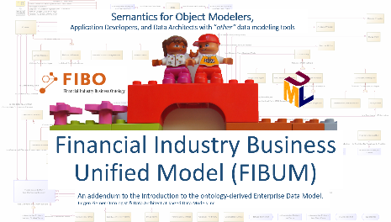
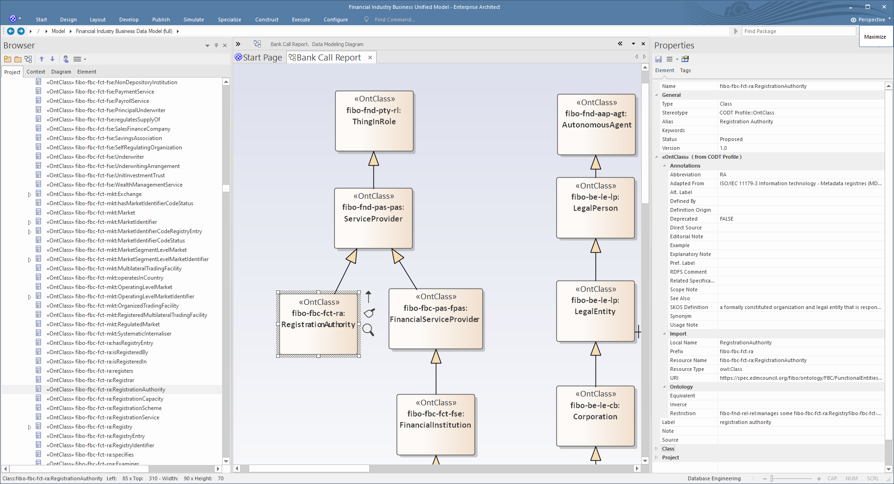
The FIBO in Sparx Enterprise Architect
https://fib-dm.com/tutorial-1-addendum/
The packages in the browser reflect the FIBO module structure.
Notice the property tags with complete FIBO documentation and lineage.

Slide 17
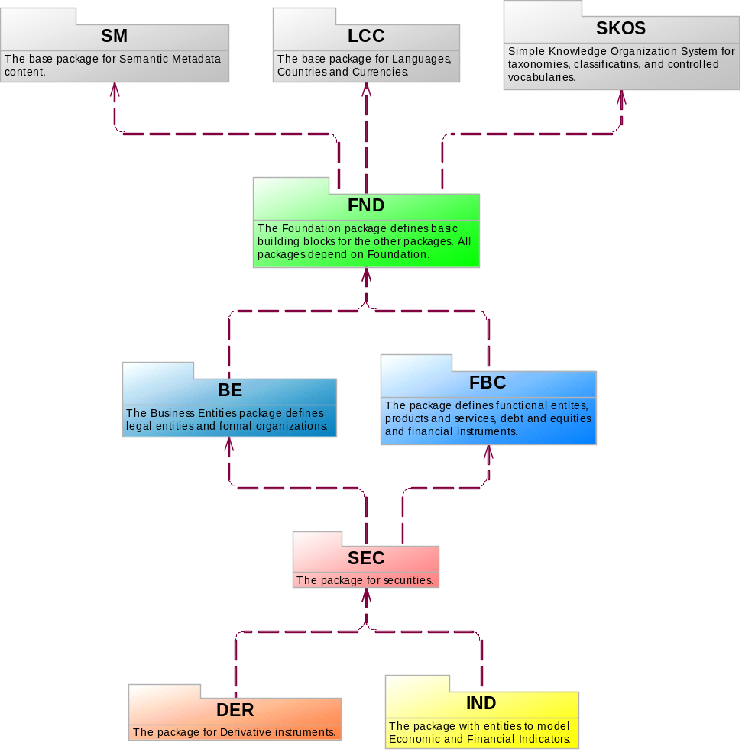
FIBO/FIB-DM modules/packages
Generic
Domain Core
Extensions
Free Open Source
Commercial License
Soon to come packages
still in FIBO development
LOAN
Loans & Mortgages
CAE
Corporate Actions & Events
MD
Market Data
CIV
Collective Investment Vehicles

Slide 18
Version, support & maintenance
As of November 10, 2010:
143 Downloads (form submissions)
Most downloads are from Banks and Investment Companies on ERWin and PowerDesigner.
16% of FIB-DM users are on Sparx EA.
FIB-DM has a major annual release, following the EDM Council FIBO Production schedule.
There are interim model upgrades when new ontology modules release into production.
Licensees with maintenance contracts get the FIB-DM version six weeks after the FIBO release.
The current FIB-DM version is as of FIBO Q4 Production, released in January 2019.
The next major release comes in February/March 2020.

Slide 19
Path and special offer for EMB
2019, adopt the Industry Standard, FIBO data and concept model
2020, train data architects in OWL. Customize FIBO to become your Enterprise Ontology
2021, Semantic Enterprise Information Architecture
Immediate ROI using the FIBO content and design patterns from day one.
Easy to learn a new language, OWL and tooling; if you already know the content and design.
Become a reference implementation, and I can teach and advise you.

Slide 20

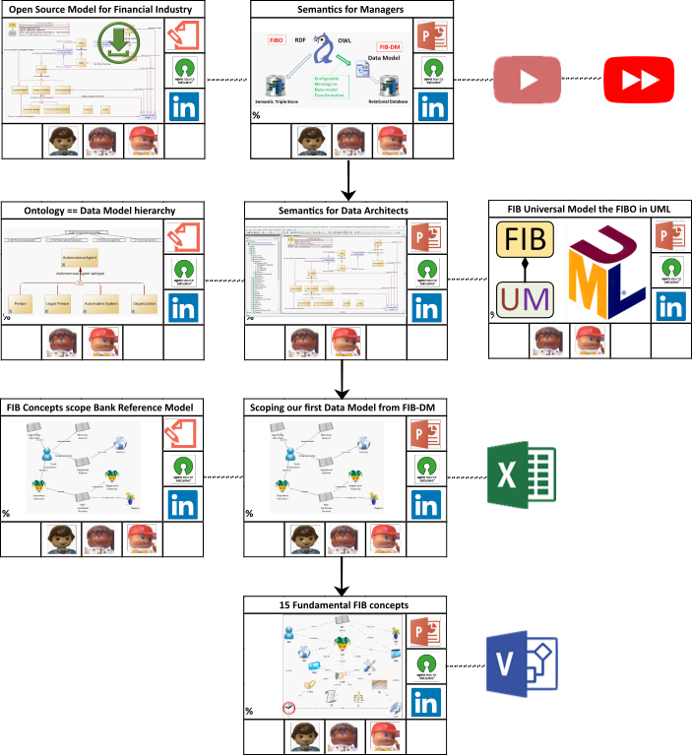


Further reading and watching
Education path, visual guide to FIB
The FIB-DM website
scalable SVG diagrams of the complete subtype hierarchies
https://fib-dm.com/financial-industry-business-concept-diagrams/
Diagrams of the Concept Maps
https://fib-dm.com/financial-industry-business-concept-relationships/
Follow the FIB-DM LinkedIn page for news, updates, and to read and share comments.
https://www.linkedin.com/showcase/fib-dm/
Watch FIB-DM Education videos on YouTube.
https://www.youtube.com/c/fibdm

